Slide 1
Model-based Testing
TQSO
Manuel Seixas
Vítor Castro
December13th, 2013

Slide 2
What is Model-based Testing?
Software Testing based on a model that describes how the application is supposed to behave.
The model is created from the analysis of the system requirements.
The model is used to automatically generate test suites to be executed against the System Under Test (SUT).
Notes:
Because Test Case are based in a model and not in the source code, model-based testing is seen as from of black-box testing
The model is usually translated into a finite state machine that represents all possible system configurations
If we have a complex system, we have too a finite state machine with a lot of paths so we should use na heuristic to find the most important paths

Slide 3
Generated test suites
These suites contain:
Test Sequences: series of input parameters used on the SUT.
Oracles: The authority which provides the correct result used to make a judgment about the outcome of test case.
Passed
Failed

Slide 4
Requirements Tracking
Manual
Technical Document
Requirements Spec.
Model or Test Design
Test Suite
Logs
Captures
Automated
Notes:
Esquema

Slide 5
Model-Based Testing
Feedback
Requirements
Feedback
Model
Feedback
Generate
Test Suite
Inputs
(Test Sequences)
Expected Outputs
(Test Sequences)
Veredict
Observe
Control
Feedback
Implementation
Notes:
Esquema

Slide 6
Models
Pre/Post (Z, VDM, Spec#, Java Modeling Language)
Best for data-oriented systems
Transition-based (FSM, Petri nets)
Best for control-oriented systems
Notes:
Different kinds of models
Formal Notations

Slide 7
Test Coverage Criteria
Structural model coverage criteria
Data coverage criteria
Fault-based criteria
Requirements-based criteria
Others
Notes:
Structural model coverage criteria – These deal with coverage of the control-flow through the model, such as cover al states, all transitions and all paths
Data coverage criteria – These deal with coverage of the input data space of na operation or transition in the model, such as boundaries, one value, all values and random value
Fault-based criteria – These generate test suites that are good at detecting certain kinds of fault in the model, such as mutating the model
Requirements-based criteria – This aim to generate a test suite that ensures that all the informal requirements are tested, either by the recording inside the behavior model or by formalizing each requirement and use that formal expressions as a test selection criterion

Slide 8
Test Case Generation
Purpose → Concretize abstract test suite to executable level
The selection criteria must be defined
Each property of the system is run by the model-checker
The test cases are created as a sequence of transitions of states with inputs and expected outputs
Notes:
The test generation depends on the specification.
The model-checker tries to find a counter-example for each property. If a counter-example is produced, it can be as a test case.

Slide 9
Three Test Suite Concretization Example
Test Cases
Test Cases
Test Cases
Abstract
Adapter
Level of abstraction
Test Scripts
Test Scripts
Adapter
SUT
(System Under Test)
SUT
(System Under Test)
SUT
(System Under Test)
Concrete
a) Adaptation
b) Transformation
c) Mixed

Slide 10
Advantages
Automated test design
Models can help the refining of unclear and poorly defined requirements
More scenarios are tested compared to traditional testing
More flexible to changes in the requirements
Notes:
Automated test design – Test Suites are generated automatically
Flexibility – Since tests are automatically generated from the model, upon a change only the model needs to be modified to update all the tests. On traditional testing, it is necessary to alter all the tests that are related to the change.

Slide 11
Disadvantages
Amount of skill required to the tester to create the model
Explosion of the state-space
When a fault is found it is unknown if the cause is the SUT, the model or the requirements
Not all tests are captured
Notes:
Amount os skill required – Requires knowledge of different forms of state machines, formal languages and automata theory, in addition to expertise in the tools and scripts required to use the test automation
Explosion of the state-space – Even the simplest application can contain so many states that the maintenance of the model becomes a difficult and tedious task

Slide 12
Tools
There are tons and tons of them…
We will show you some…

Slide 13

Spec Explorer
Is developed by Windows (so support is assured);
The paid evolution of NModel (another model-based testing tool).
Not many tutorials…
But tons of references.
Uses .NET language.
The modeling is made by code, only later can the visual model be observed.

Slide 14
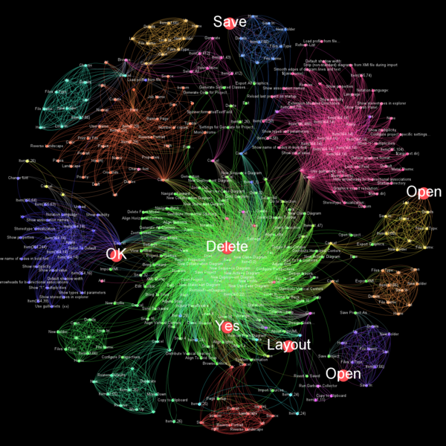
Guitar
Nice looking models! -----→
Can test GUI interfaces.
Very few tutorials (we found one) and those are difficult to understand…
Too dependent of the command promp.
You must execute 3 or 4 programs to get the final result.

Slide 15
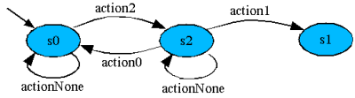
ModelJUnit
There is documentation and an examples on the tool webpage.
However, run into a problem and… lose hope. There’s probably no choice but to mail the developing tema
Resources and information scarce…
(… so scarse that there are no images or logo for this tool)

Slide 16
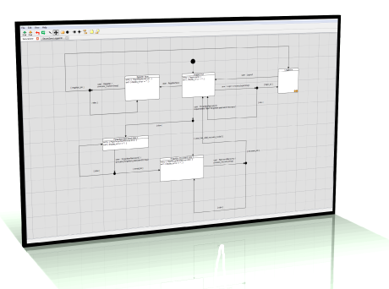
Conformiq Modeler
It’s a commercial tool (in other words, it’s paid…).
Models can be created using UML or simple text.
Uses Java for actions (you will know what we mean once we get to the exercises).
Available for Windows and Linux.

Slide 17
If you want to know more…
http://www.robertvbinder.com/open-source-tools-for-model-based-testing/
Check out this link!

Slide 18
Graph Walker and yEd Graph Editor
Two complementing tools. One for the model testing, the other for drawing graphs.
We picked this one to presente in class.
Simple. And with a lot of visual feedback.
… And now, let’s use it!

